Slide 1
Statewide Cooperative Contracts
Cherilyn Hess

Slide 2
How vendors get a statewide cooperative contract
Vendors respond to a publically posted solicitation.
E-procurement bidding service, to distribute and receive bids, RFPs, and other solicitations to create the Utah Public Procurement Place or U3P.
Solicitation Types
Set Asides – Ex. UCI, State Mail
RFP – Request for Proposal
SS – Sole Source
IFB – Invitation for Bid
RFSQ – Request for Statement of Qualifications
AVL – Approved Vendor List
Statewide Cooperative Contracts are posted as such.
Often have Admin Fee Requirements
Have Quarterly Usage Reports
Service All Eligible Users- Not just specific entities

Slide 3
Eligible Users
Who can use the contract?
Eligible User(s)” means those authorized to use State Cooperative Contracts and includes the State of Utah’s government departments, institutions, agencies, political subdivisions (e.g., colleges, school districts, counties, cities, etc.), and, as applicable, nonprofit organizations, agencies of the federal government, or any other entity authorized by the laws of the State of Utah to participate in State Cooperative Contracts.

Slide 4
How to find a contract
Go to purchasing.utah.gov
Click on State Contracts
Click on Statewide Best-Value Cooperative Contracts

Slide 5
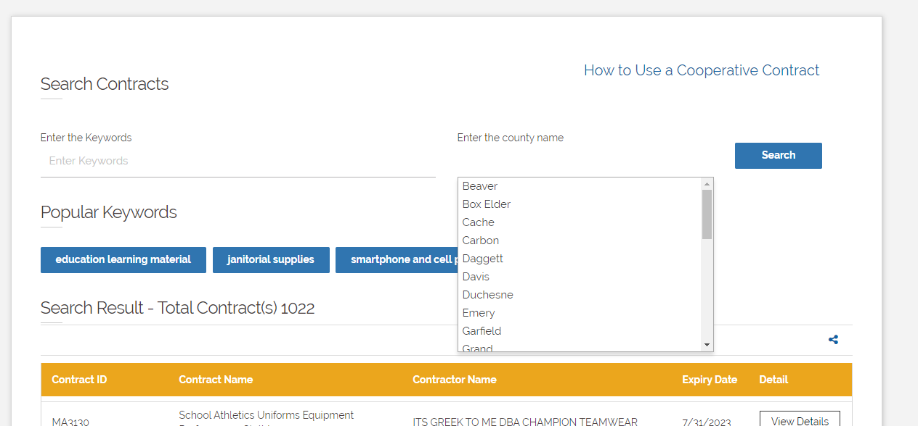
County Search
You can search by:
County

Slide 6
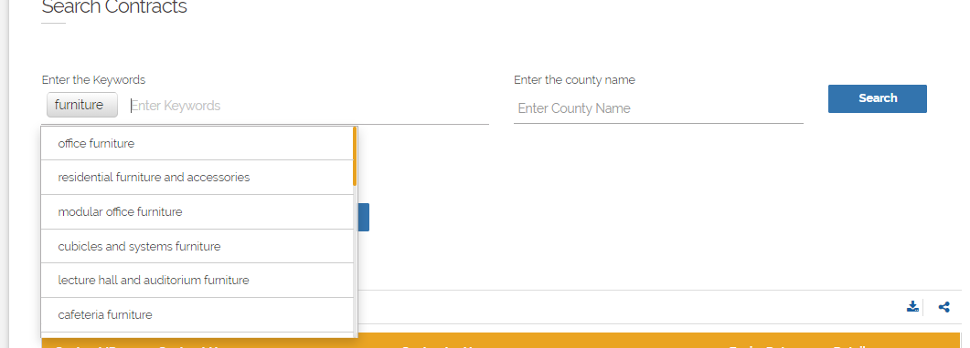
Popular Keywords
You can search by:
Vendor Name
Portfolio Name
Contract Name
Keywords (High Level)
Talk to contract manager

Slide 7
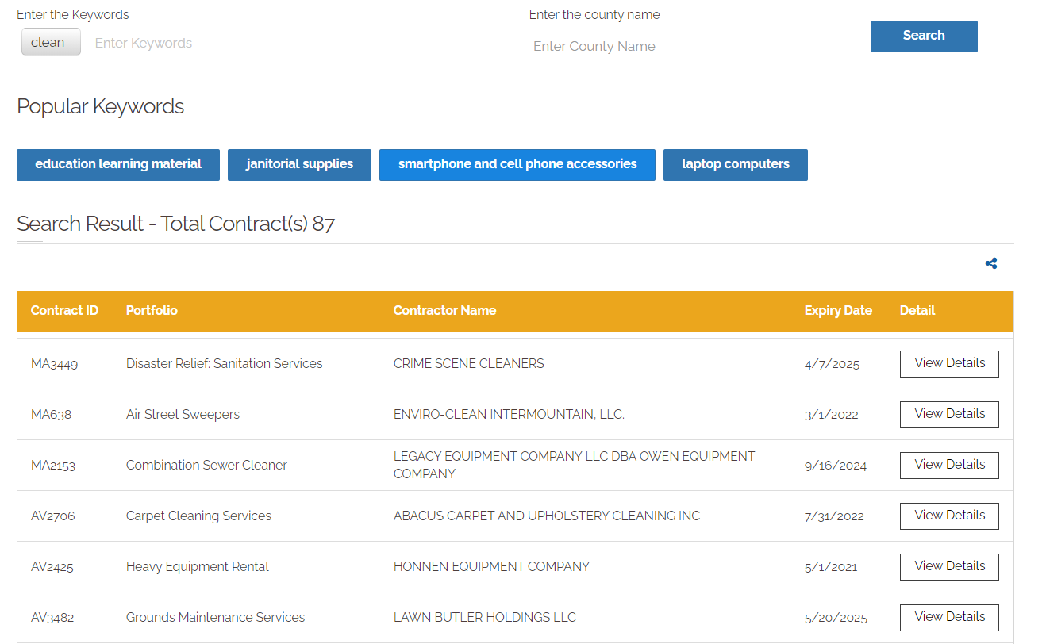
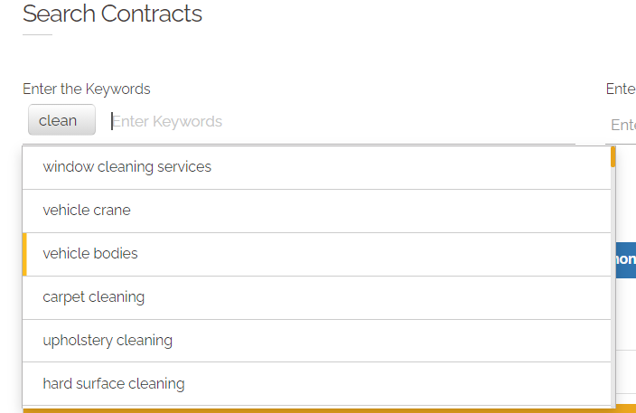
Keyword Example

Slide 8
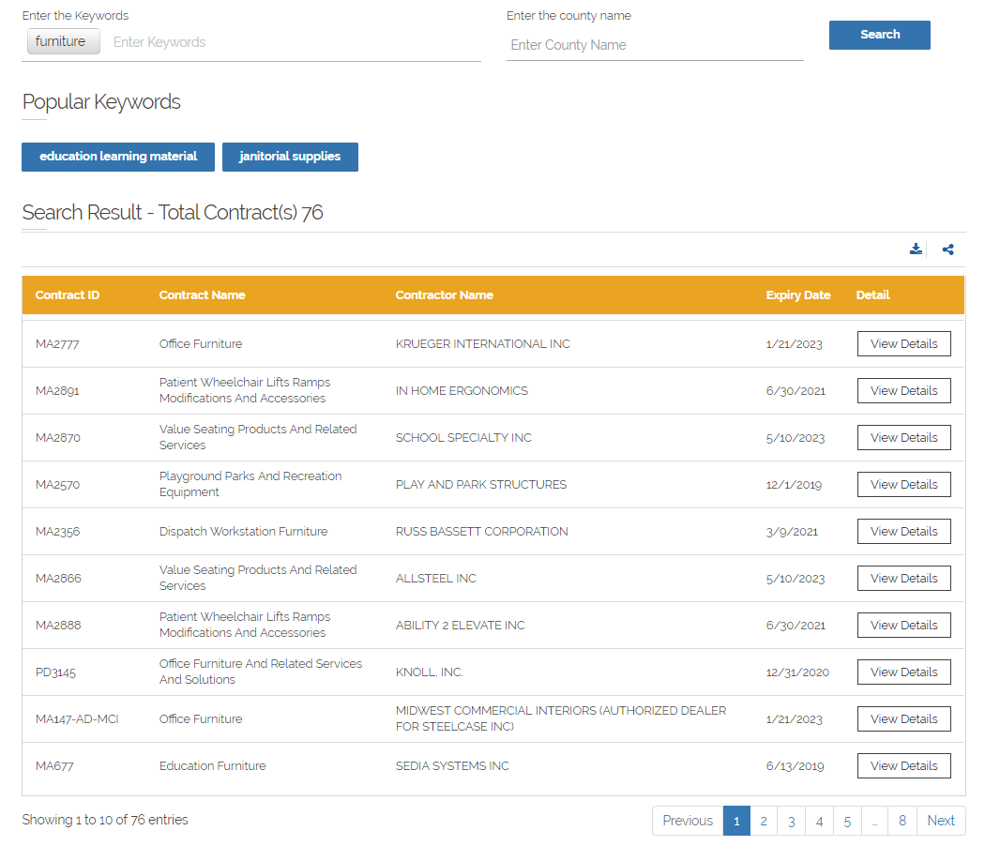
Example: Search for Furniture

Slide 9
Example: Search for Furniture

Slide 10
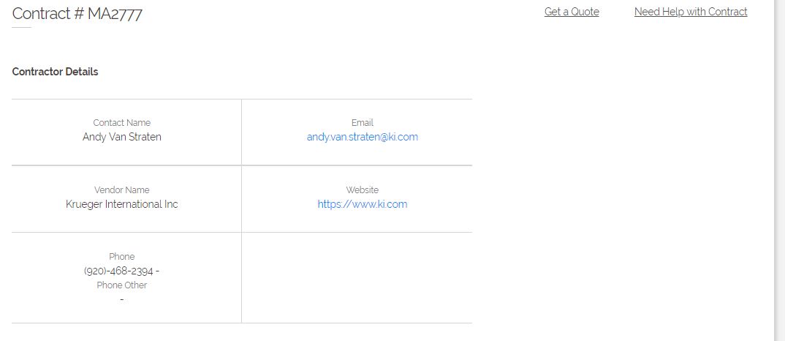
Looking at the Contract

Slide 11
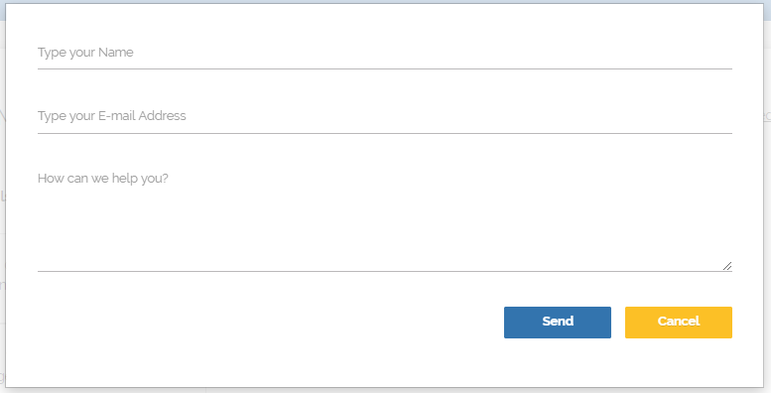
Need Help with the Contract?

Slide 12
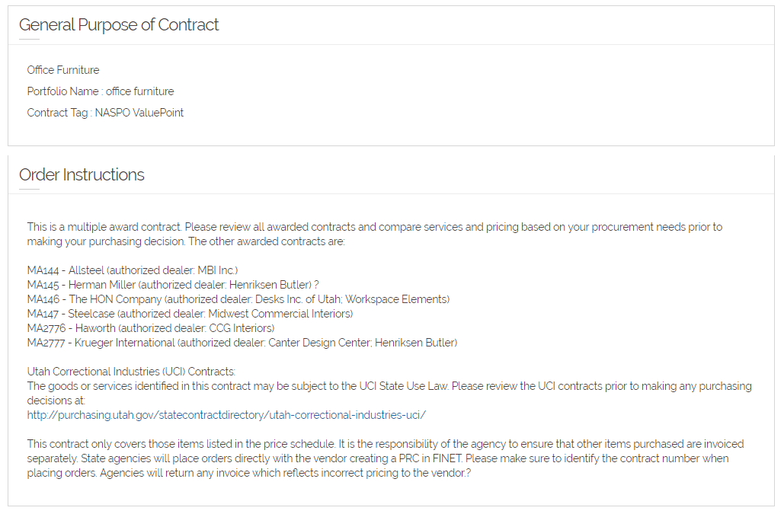
Looking at the Contract

Slide 13
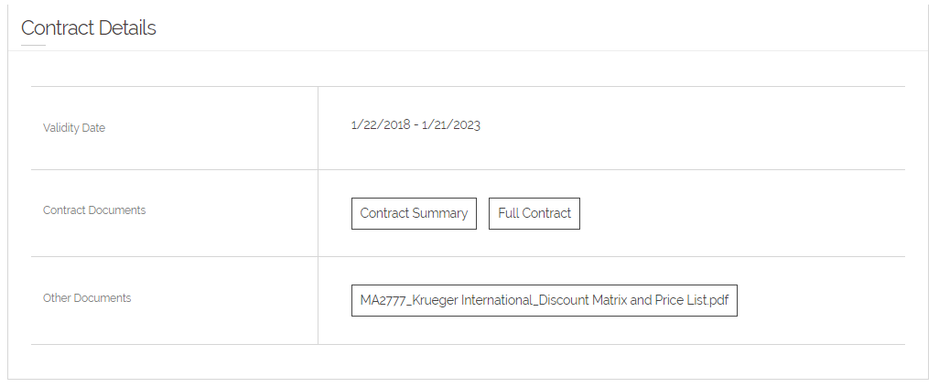
Looking at the Contract

Slide 14
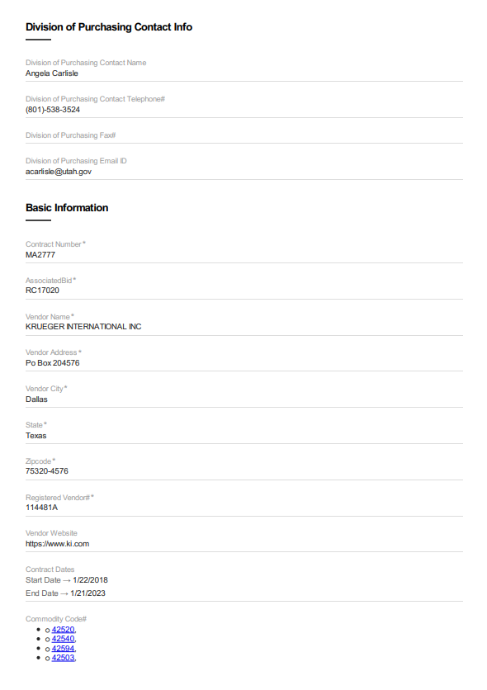
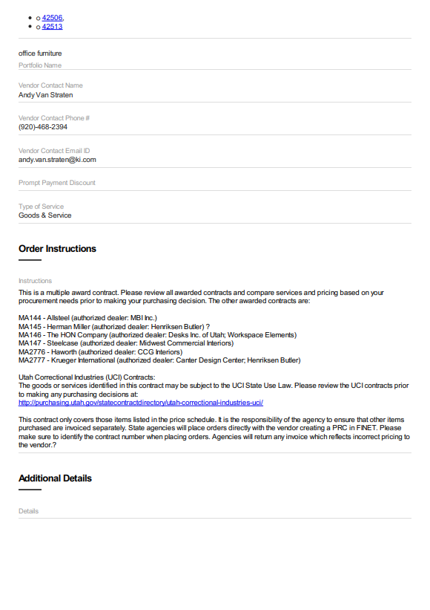
Contract Summary

Slide 15
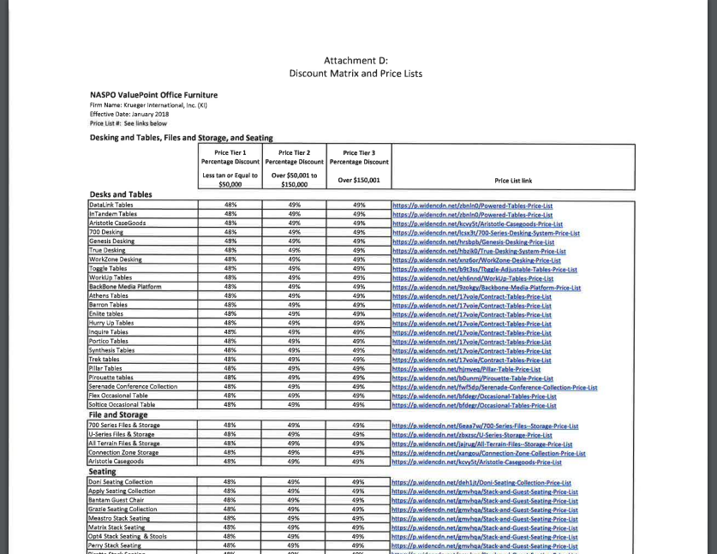
Pricing Document

Slide 16
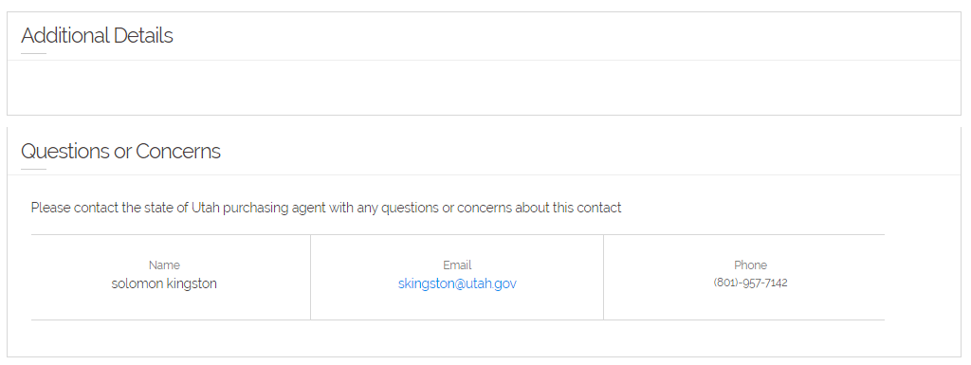
Looking at the Contract

Slide 17
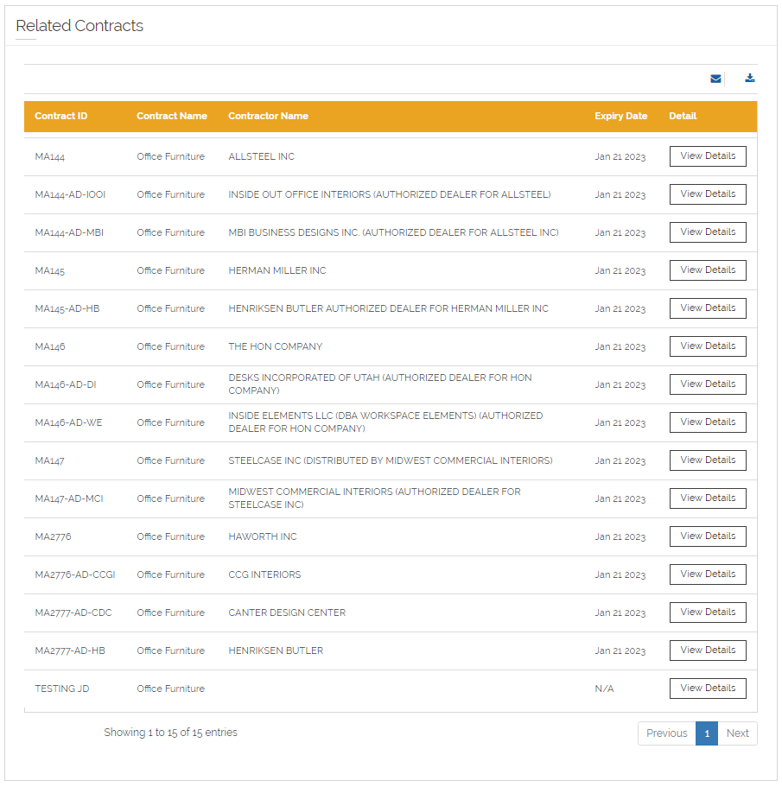
Related Contracts

Slide 18
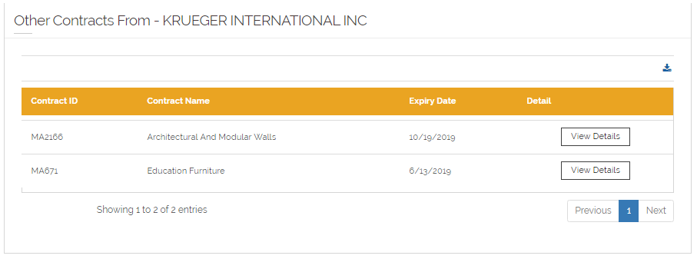
Other Contracts

Slide 19
Contract Numbering
AR Authorization Required - State Agencies must ask before buying on these contracts.
AV Approved Vendor List
MA Multiple Contracts Awarded - Multiple vendors own multiple awards
PD Awarded to one Vendor
PA Pricing Agreement – We are not starting new contracts with PA any longer

Slide 20
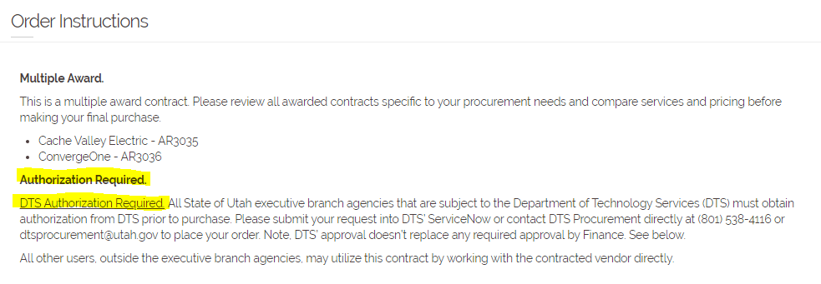
Examples of AR
AR3036 - Automated E911 System

Slide 21
Examples of AR
AR3388 – Mailing Equipment Supplies & Maintenance

Slide 22
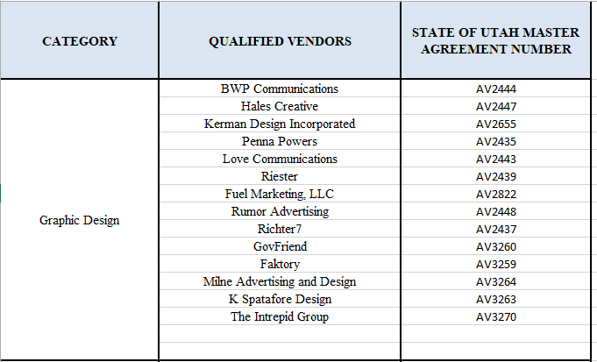
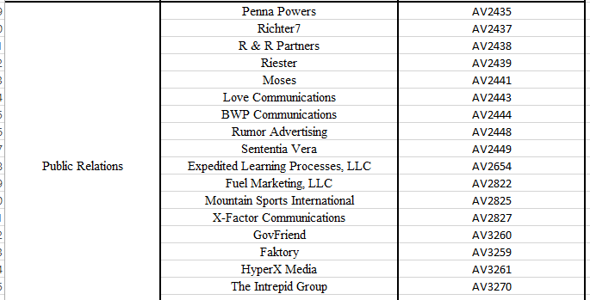
Examples of AV
AV2436 – Marketing and Advertising Services

Slide 23
Examples of AV
AV2706 – Carpet Cleaning Services

Slide 24
Example of MA
MA3178 – Turf Management Products

Slide 25
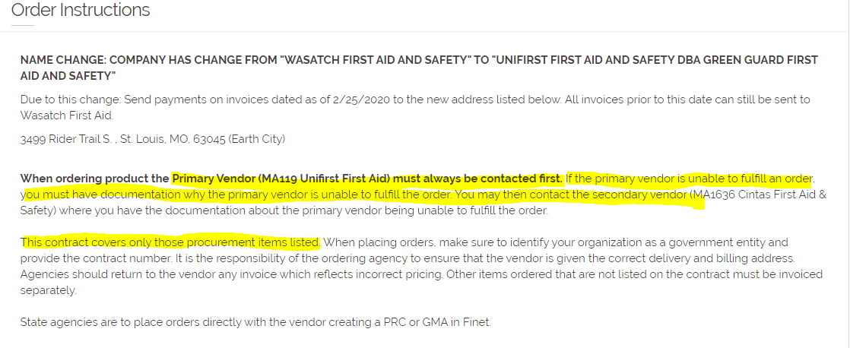
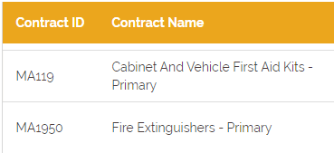
Example of MA
MA119 – Cabinet and Vehicle First Aid Kit- Primary vs Secondary

Slide 26
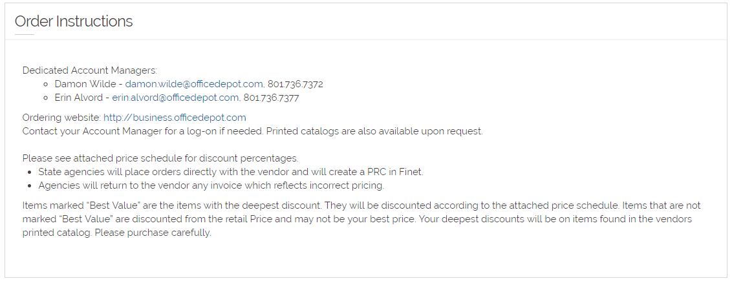
Get a Quote Review Ordering Instructions Before Requesting Quotes

Slide 27
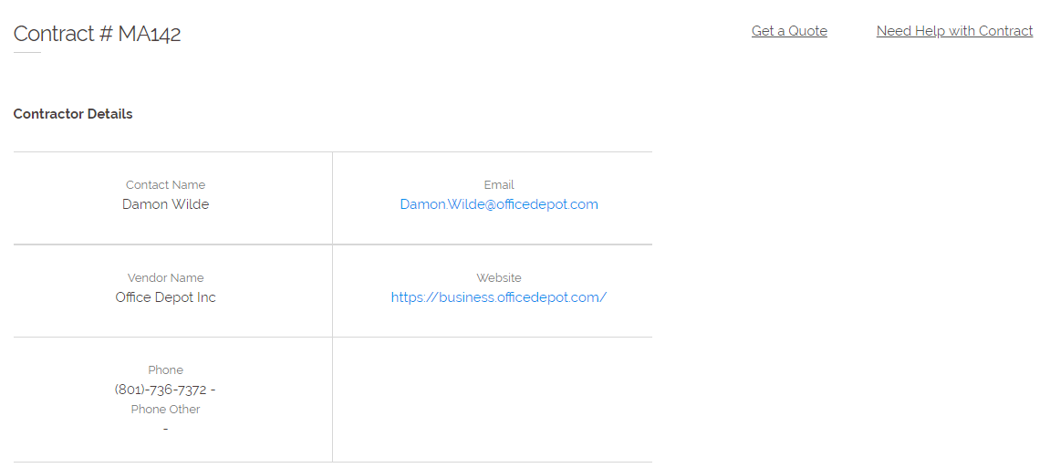
Get a Quote Search - Tips and Trick

Slide 28
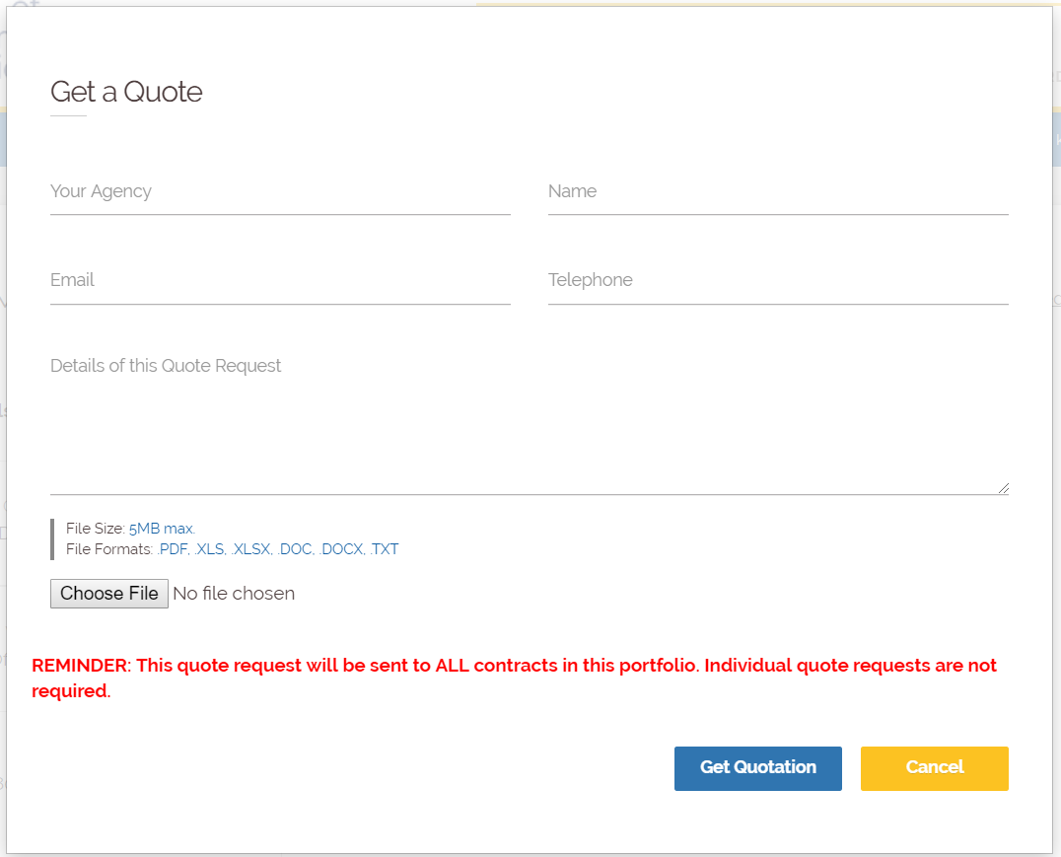
Get a Quote

Slide 29
Get a Quote General Tips and Tricks
If you are requesting multiple items -- ask if vendors offer volume discounts! There is nothing to lose by asking and you can receive competitive pricing by requesting volume discounts.
Make sure to include a deadline! Let the vendor know the date and time the quotes are due back.
Also a best practice to include your email in the body of the text -- this will encourage the vendor to reach out to the correct entity.
Err on the side of providing too much detail to the vendor regarding what you want -- for example, think dimensions, materials, color, model, and brand equivalent (if necessary) if you are purchasing an item.
You can also upload an attachment to the Quote Request
It is also a good idea if you are buying an item to make sure the vendor knows the shipping location so they can include that in their quote.

Slide 30
Get a Quote
When you hit the “Get a Quote” button… who ends up receiving an email?
EVERY VENDOR IN THE PORTFOLIO - what does that mean?
When you are requesting a quote, you only need to click the “Get a Quote” button ONCE on ONE contract in order to request quotes from all vendors associated with the good or service you are seeking. What a time saver!
You will receive a copy of the email sent out, which you will be able to save for your records.

Slide 31
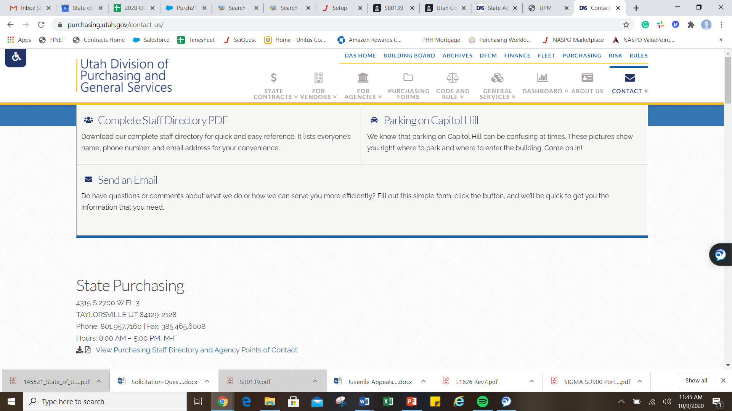
Suggestions for New Contracts?
Email Windy Aphayrath at waphayrath@utah.gov
Send your suggestions through contact us on our website

Slide 32
Questions & Answers
Cherilyn Hess
(801) 957-7147
chess@utah.gov
Brown Bag Training Suggestions & Certificates
Solomon Kingston
skingston@utah.gov

